Slide 1

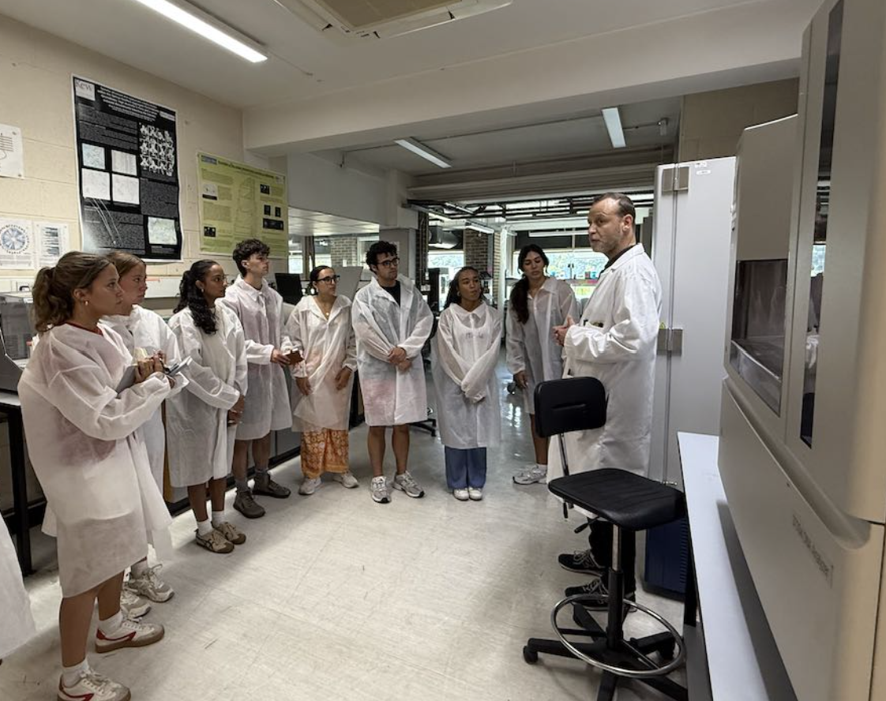
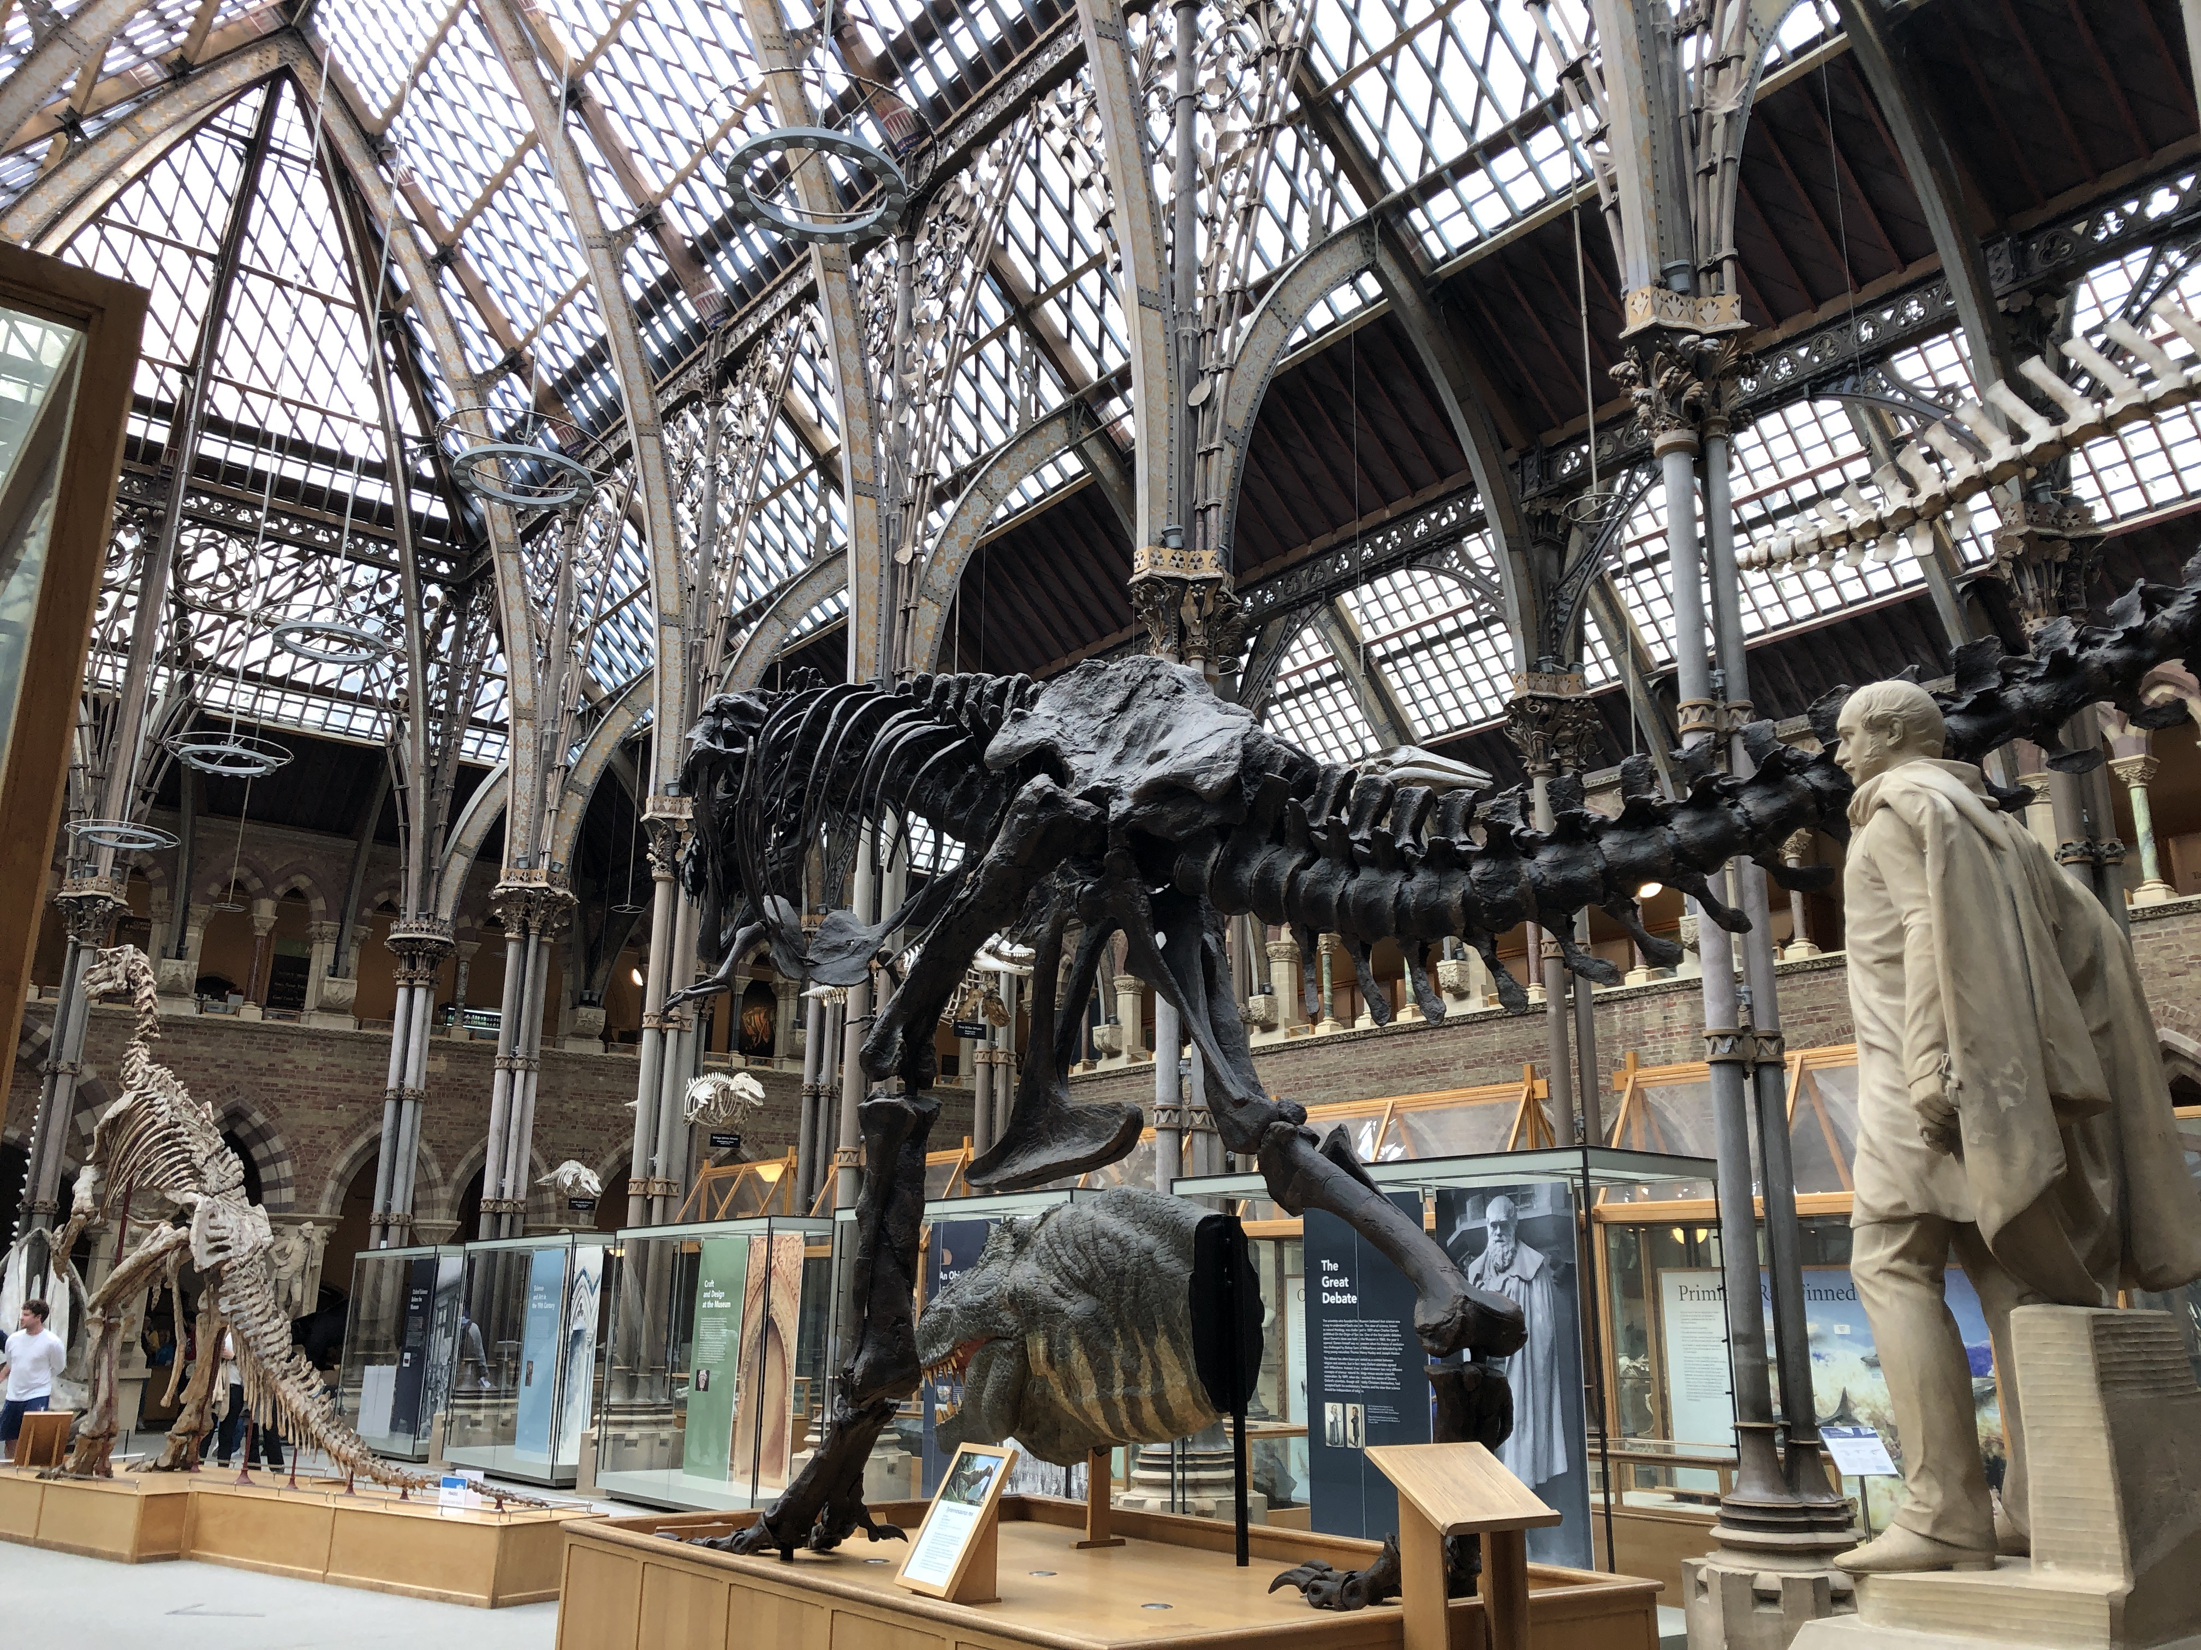
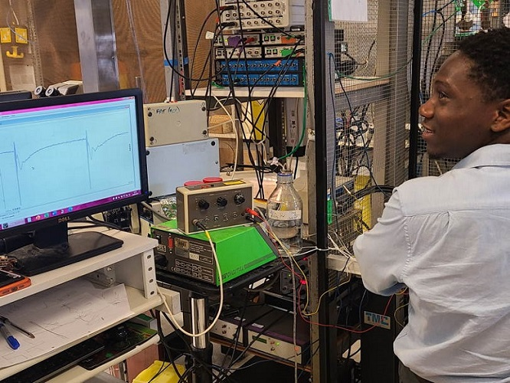
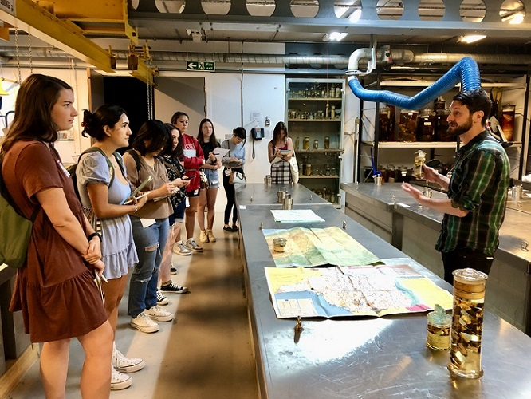
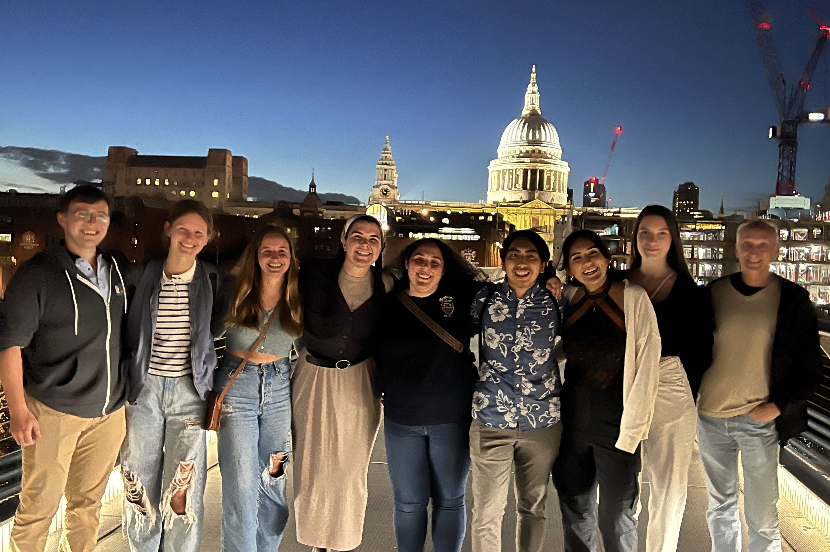
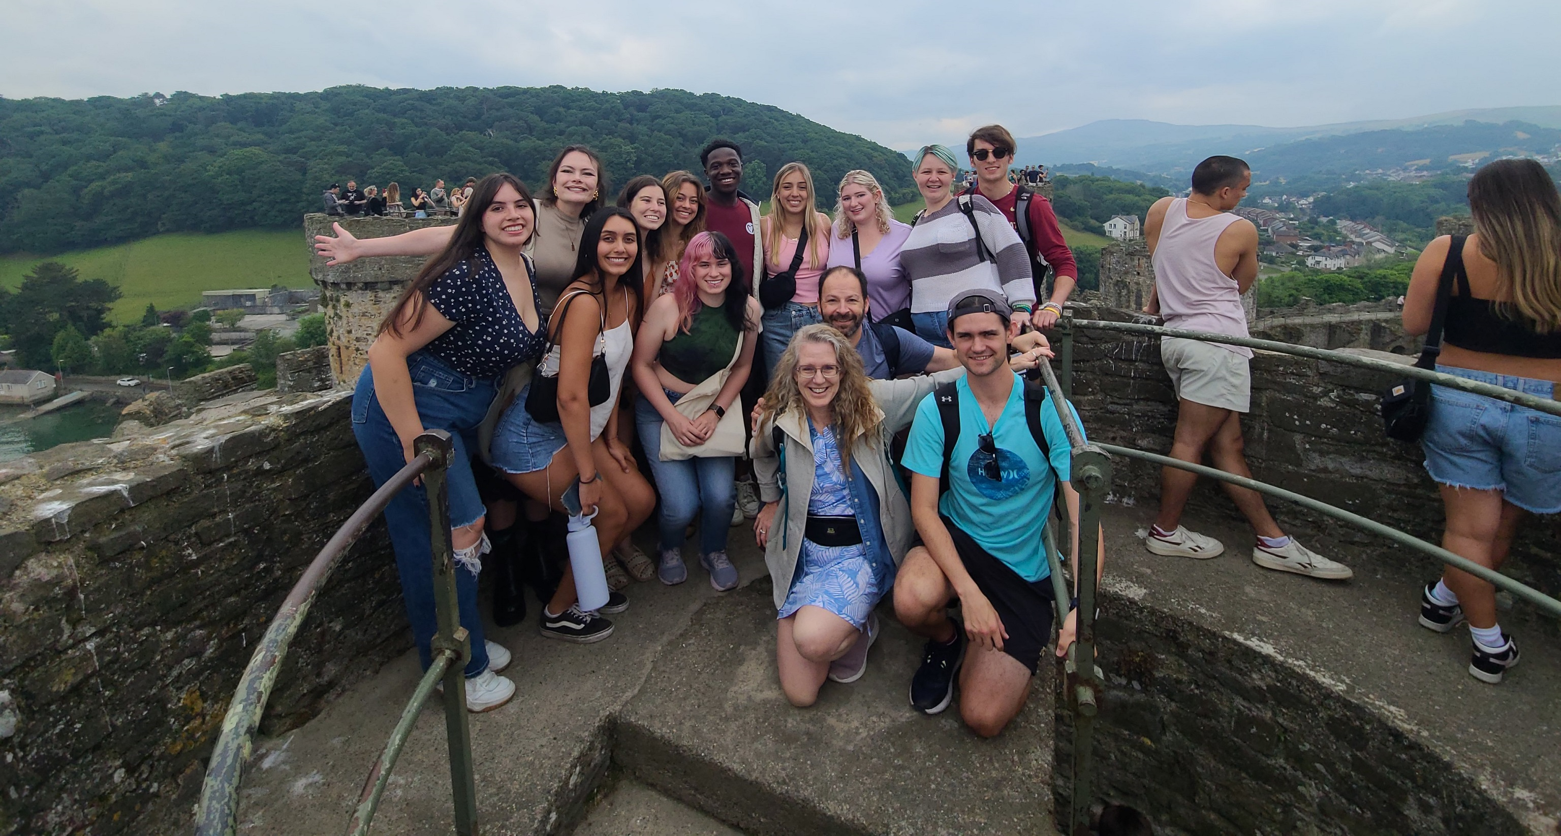
Biology in London

Slide 2
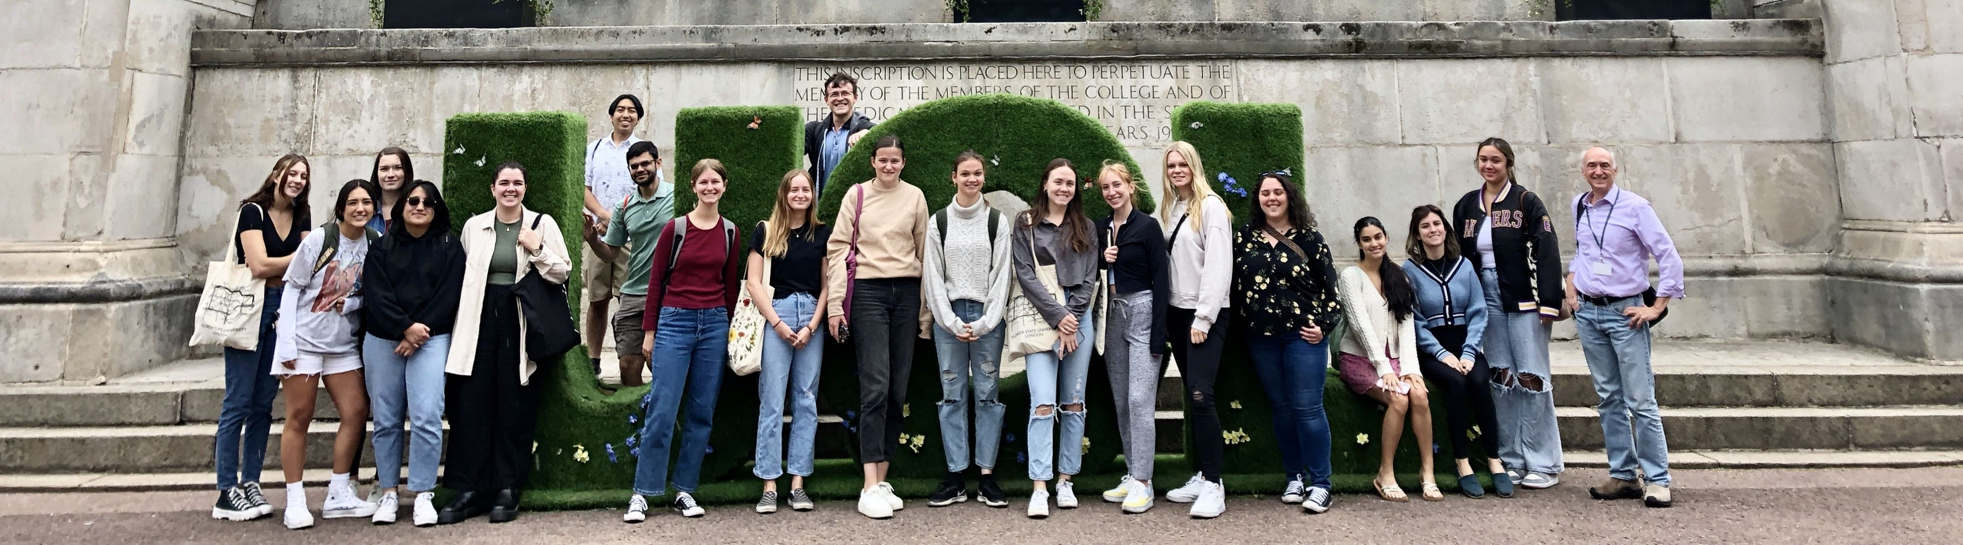
Biology in London Program — Summer 2026
A departmental program targeted to majors during the summer in London
Two upper division classes, offered sequentially over eight weeks (June 5 – August 2)
Open to non-majors as well

Slide 3
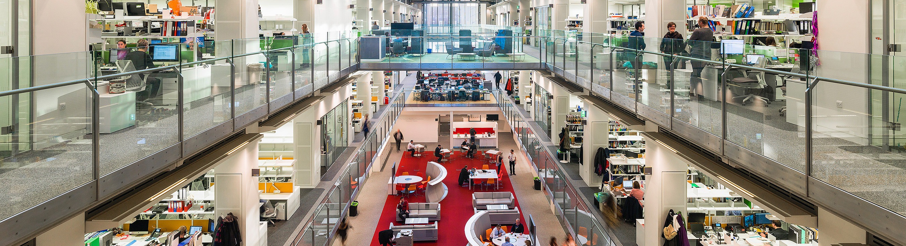
Biology in London Program — Summer 2026
Why study biology in London?
Live in a safe, vibrant city in a foreign country
Satisfy graduation requirements (2 electives)
Small class sizes and more personal interaction with teachers
Learning experiences and resources not available in Florida (esp. museums)
The Francis Crick Institute

Slide 4
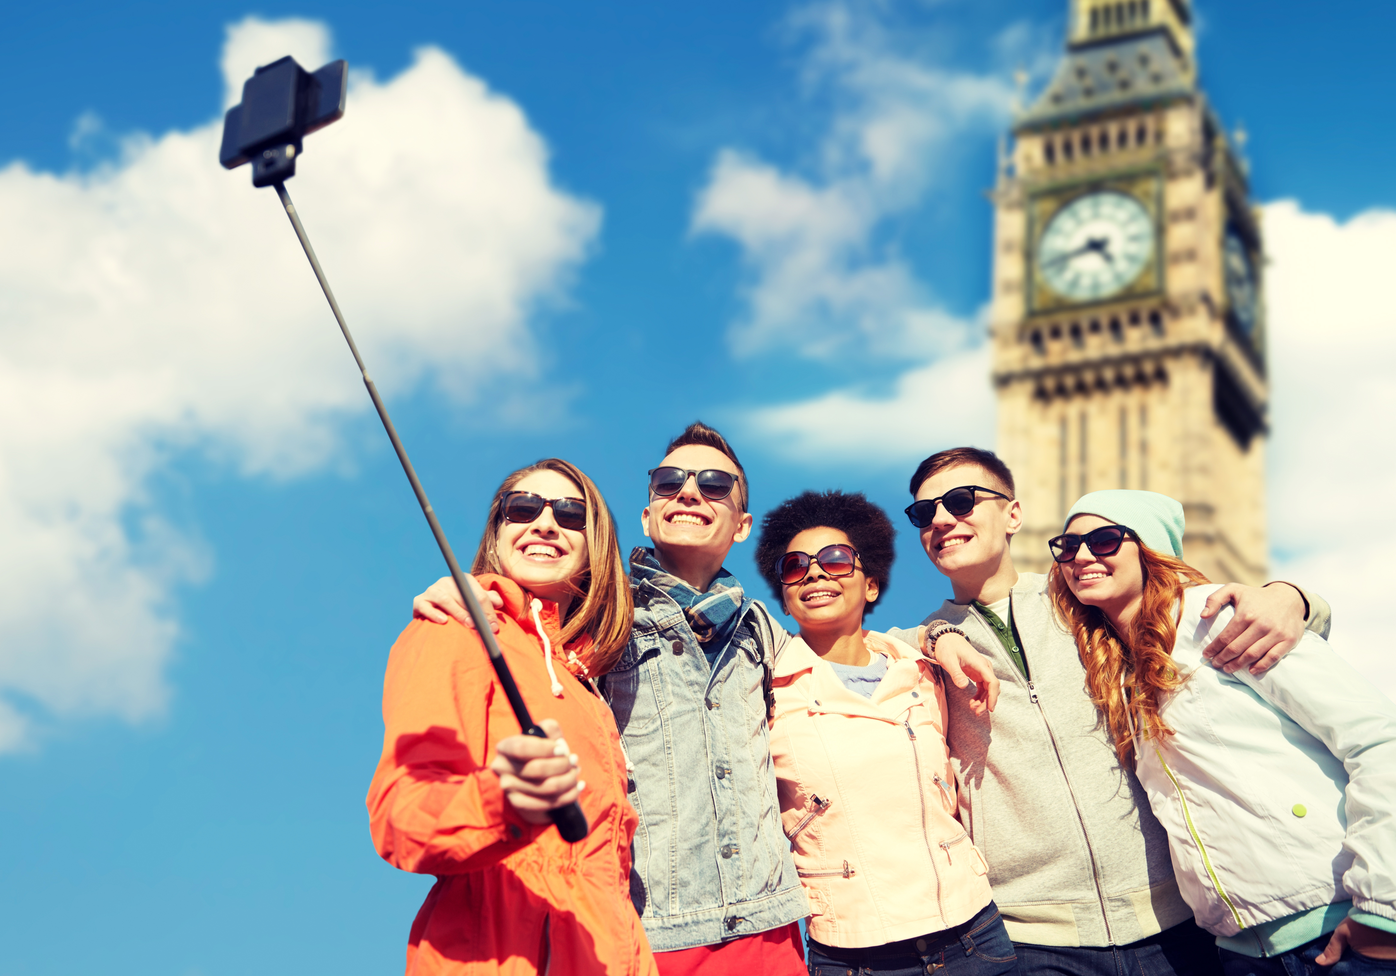
The London Experience

Slide 5
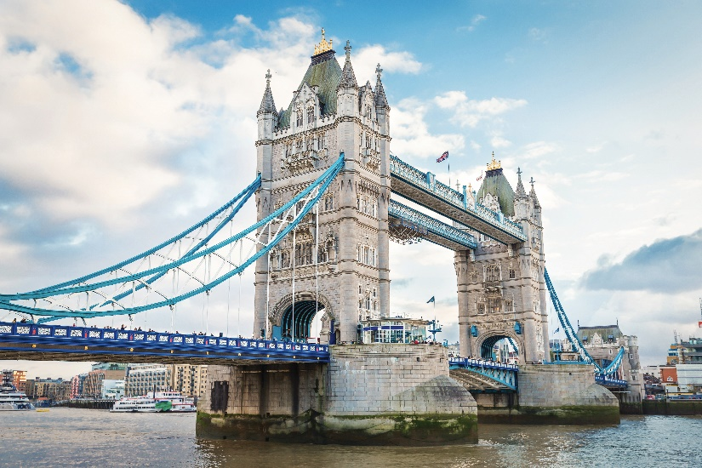
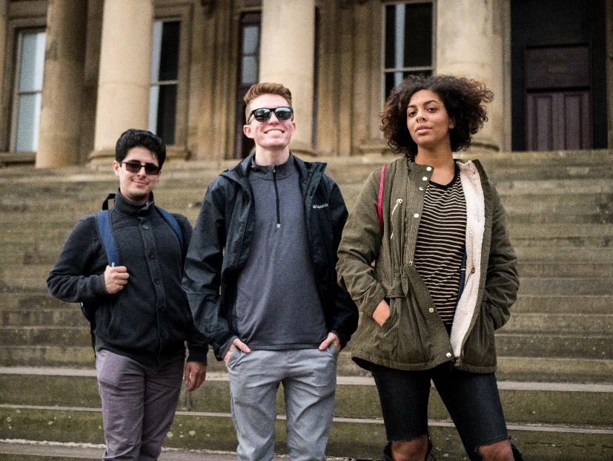

Florida State University’s International Programs is proud to celebrate more than 65 years of experience in international education and is a nationally recognized leader in the field of study abroad programs.

Slide 6
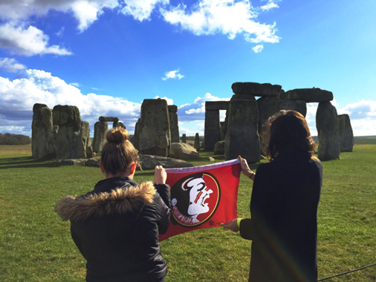
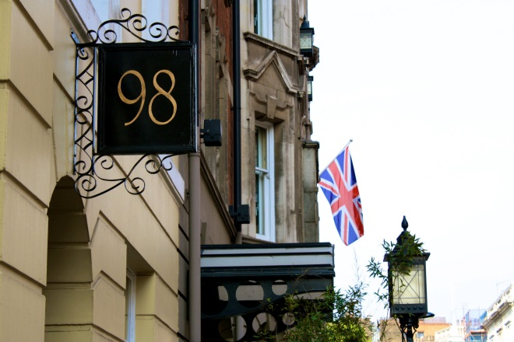
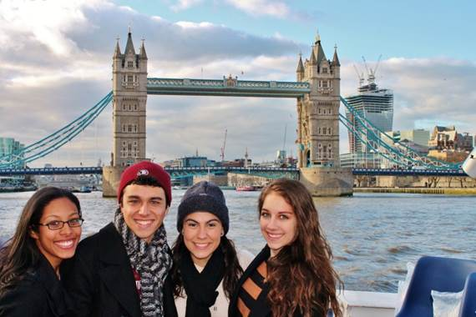
London Study Center
Centrally located, two blocks from the British Museum and University College, London
Walk to Covent Garden, Trafalgar Square, and Houses of Parliament
Lots of FREE cultural events through the Broad Curriculum social calendar, including weekend excursions to cities such as Lake District, Bath or York, plus day trips and plays.

Slide 7
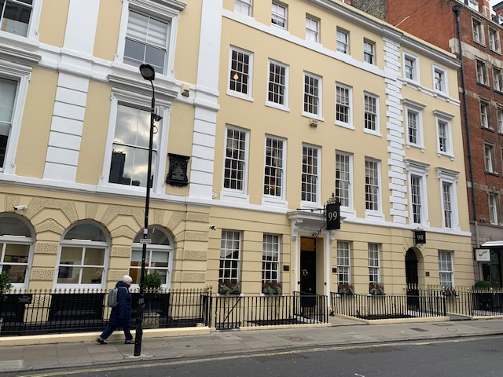
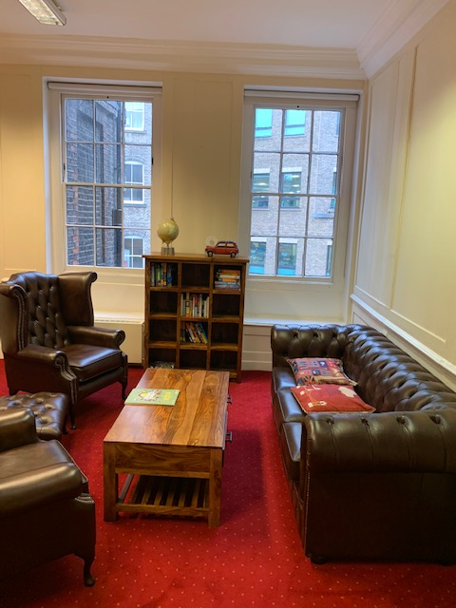
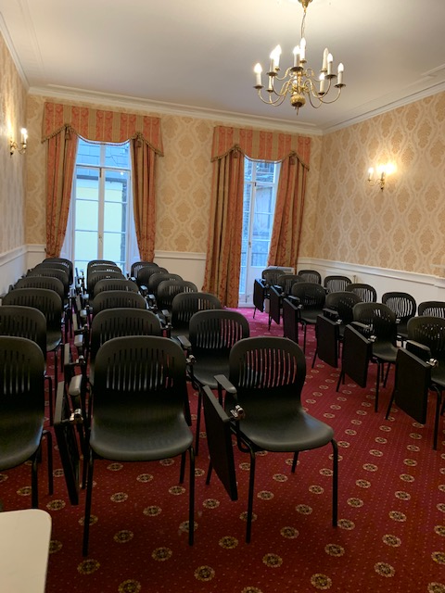
London Study Center

Slide 8
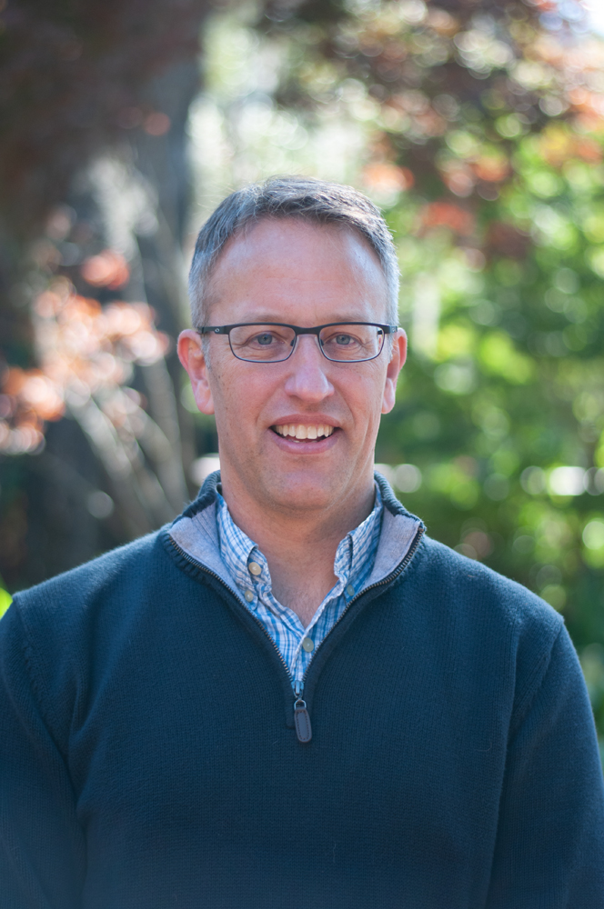
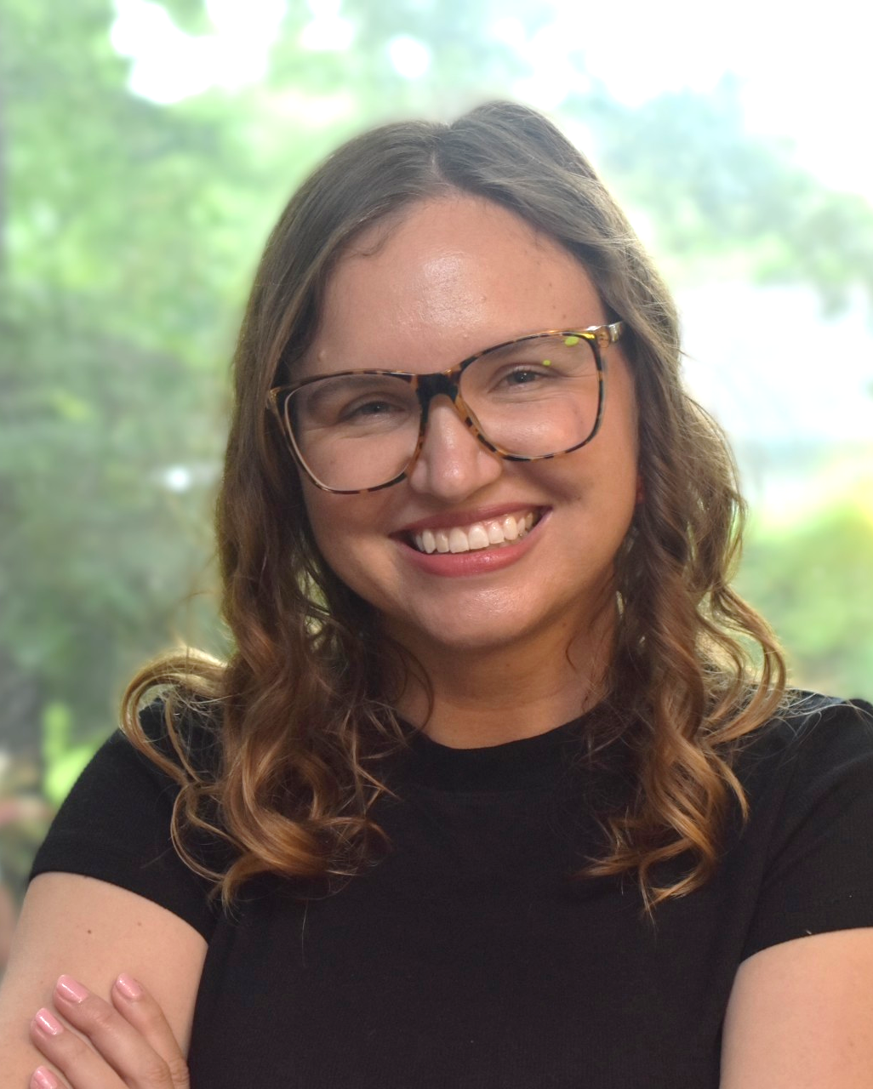
Biology in London Program — Summer 2026
Classes to be offered:
BSC 4933 Walking In van Leeuwenhoek’s Shoes: Rediscovering Cell Biology in London (3 credit hours)
Taught by Dr. Scott Stagg
BSC 4933 Investigating Questions in Animal Behavior (3 credit hours)
Taught by Dr. Brittany Kraft

Slide 9
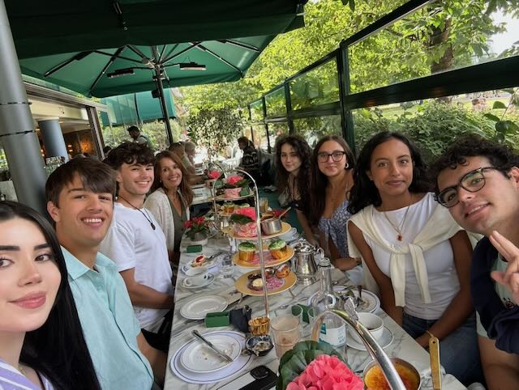
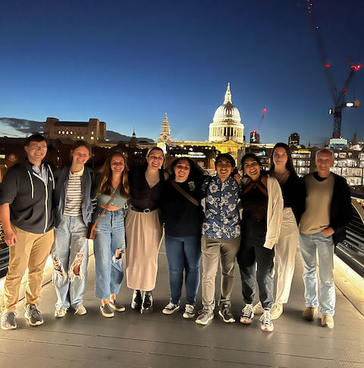
Biology in London Program
The London Experience: Cultural Calendar
Afternoon tea
After the farewell Shakespeare play

Slide 10
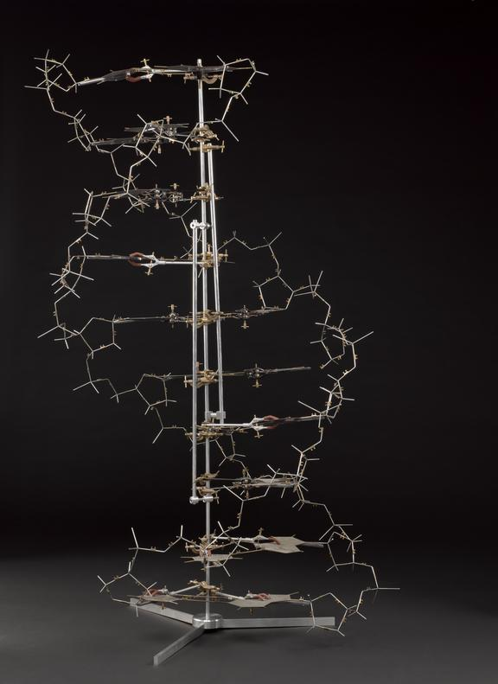
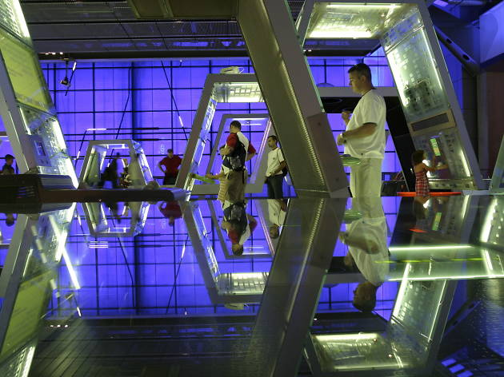
Biology in London Program
Science Museum

Slide 11
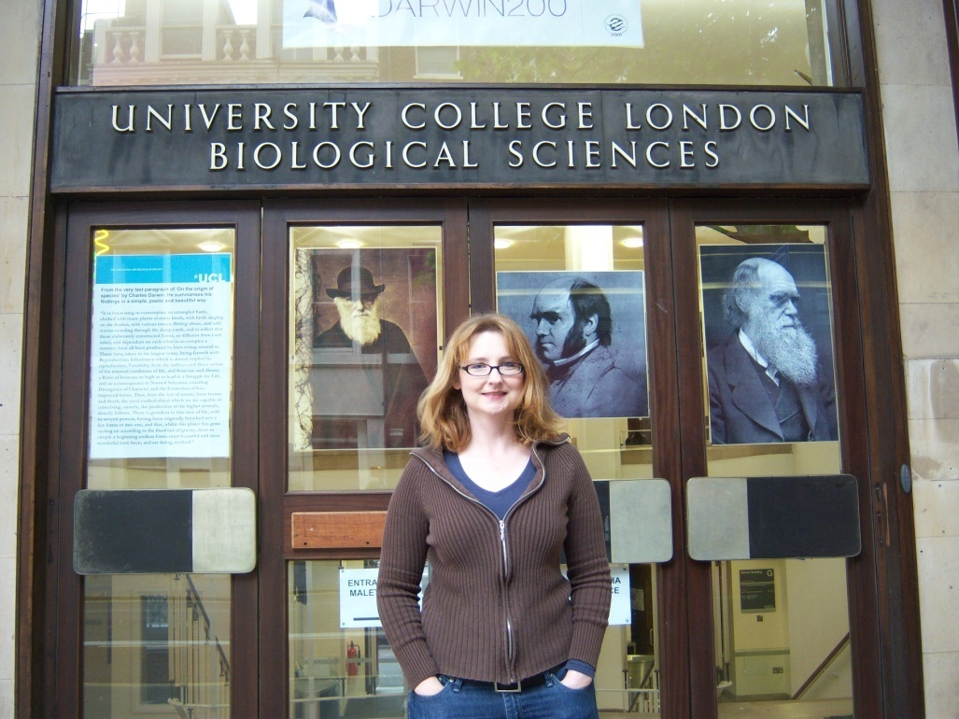
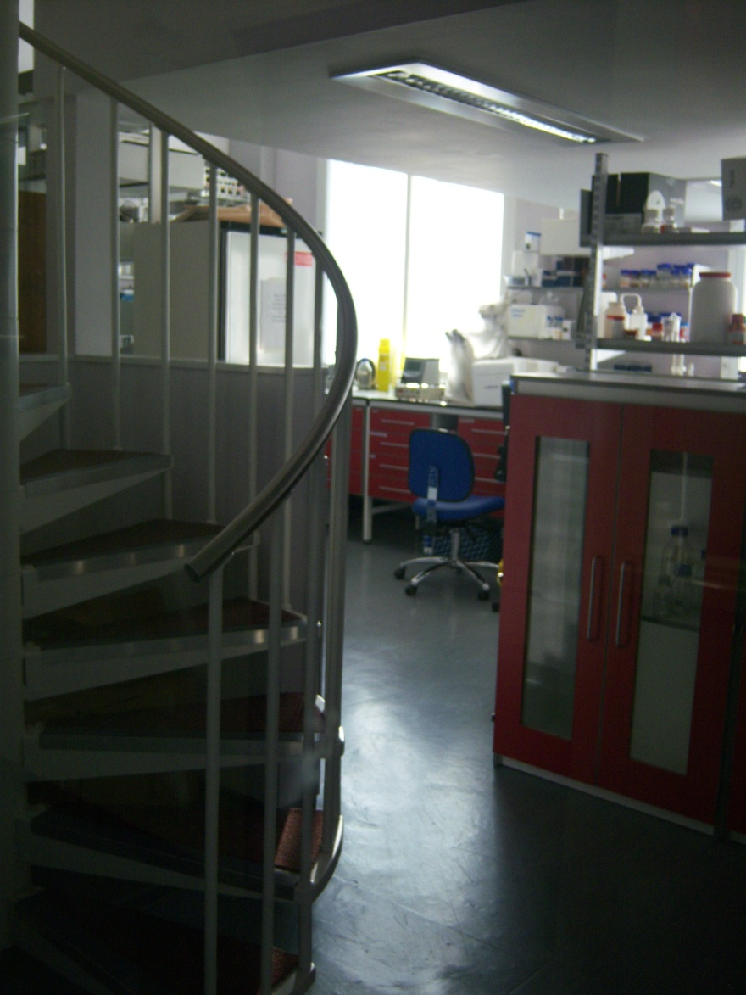
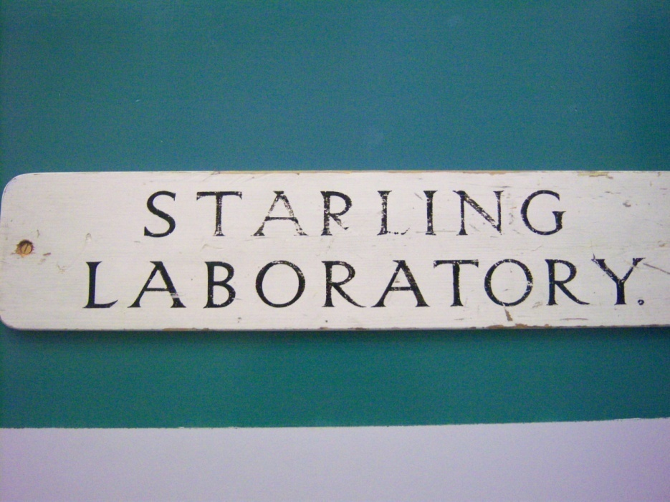
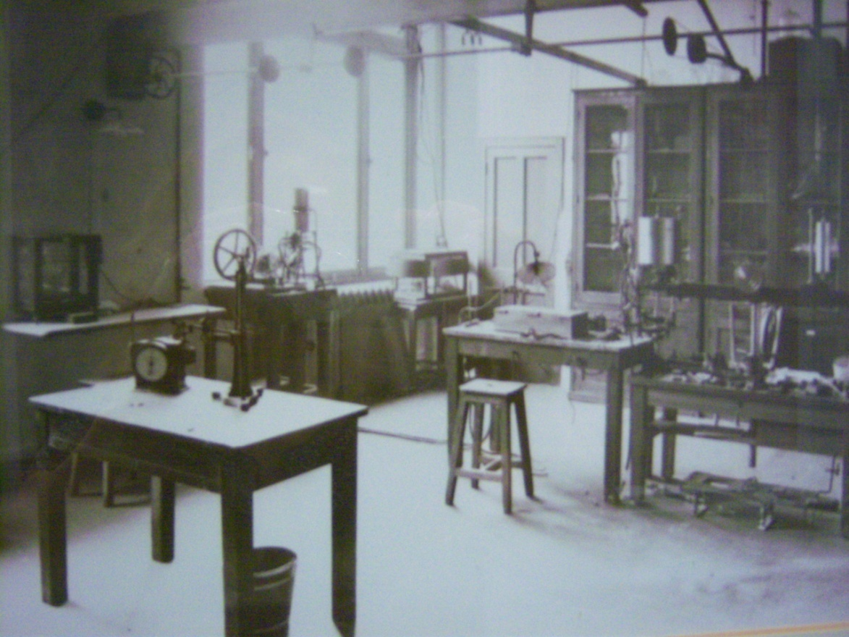
Biology in London Program
The London Experience
Visit to University College, London

Slide 12
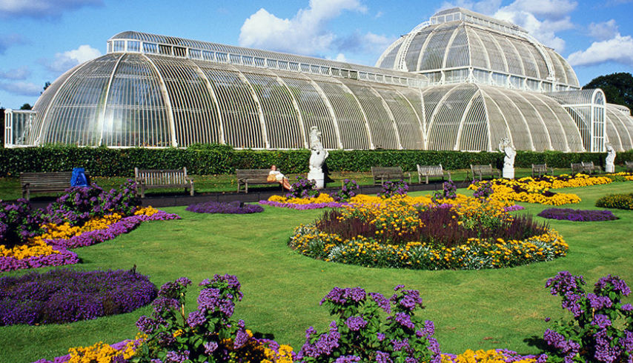
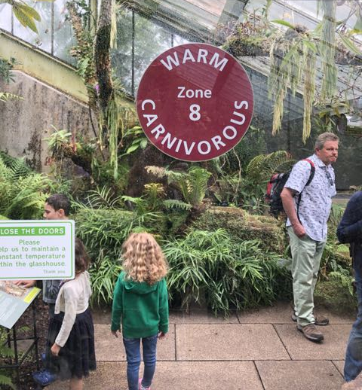
Biology in London Program
The London Experience: Royal Kew Gardens

Slide 13
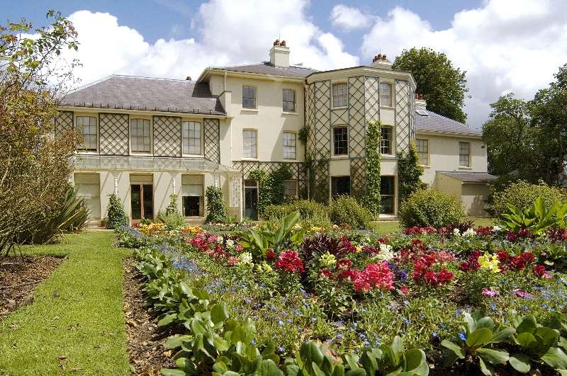
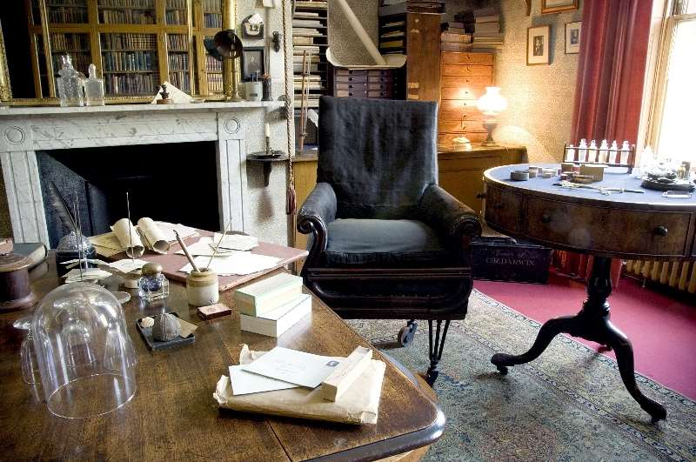
Biology in London Program
The London Experience: An historical perspective Darwin’s House (Down House)

Slide 14
Biology in London Program
The London Experience: An historical perspective
The cholera well
Smallpox vaccination

Slide 15
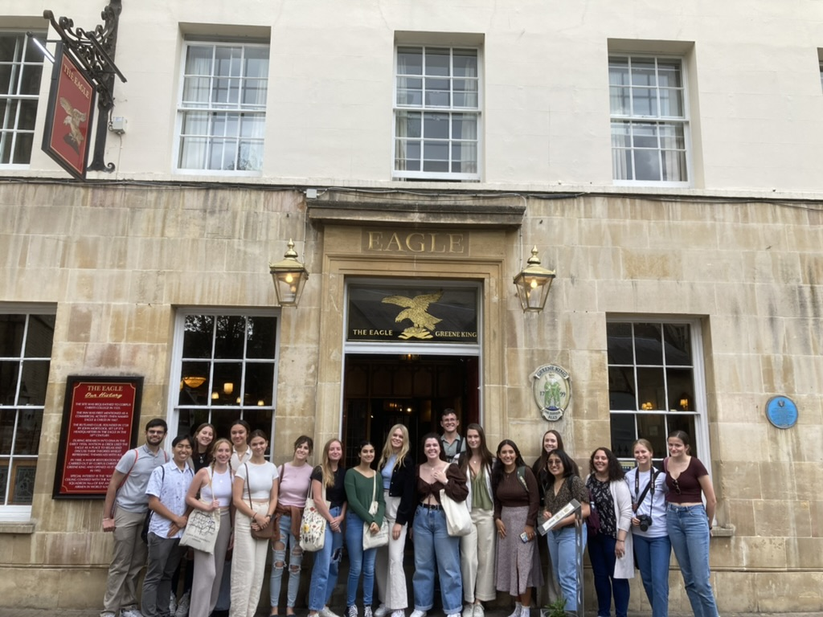
Biology in London Program
Cambridge: A guided tour with a scientific historical perspective
The Eagle Pub

Slide 16
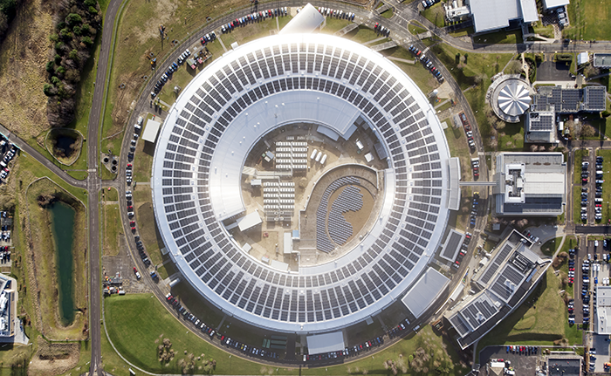
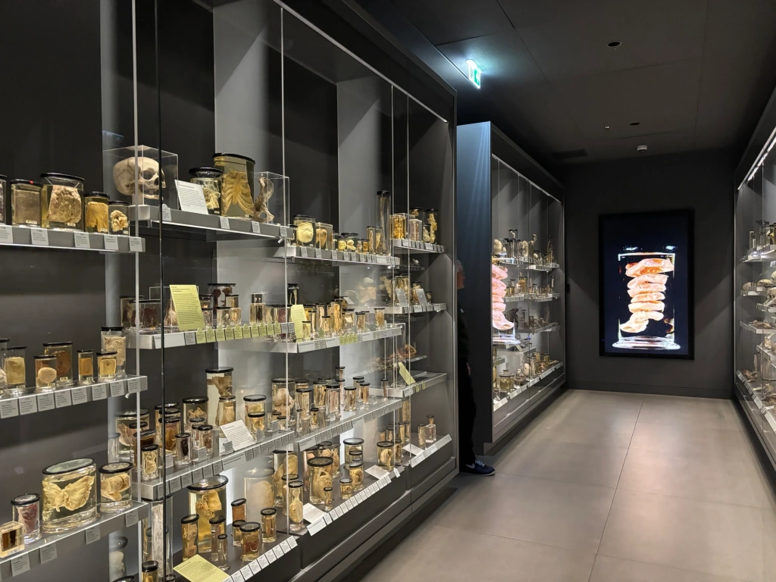
Biology in London Program — Summer 2026
BSC 4933 Walking In van Leeuwenhoek’s Shoes: Rediscovering Cell Biology in London
How do we know about cells and how they function? In this class students will recreate classical experiments that shaped our understanding of the cell. Before the advent of modern tools, scientists such as Antonie van Leeuwenhoek built their own instruments and made discoveries that transformed biology.
Science Museum
Hunterian Museum
The Diamond Light Source
Royal College of Physicians Gardens
Birkbeck
Francis Crick Institute
DIY Experiments around London
Notes:
Diamond Light Source is the UK’s national synchrotron. It works like a giant microscope, harnessing the power of electrons to produce bright light that scientists can use to study anything from fossils to jet engines to viruses and vaccines.
The eagle pub

Slide 17
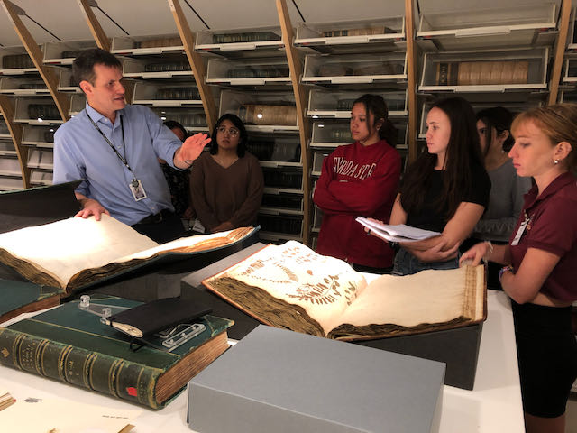
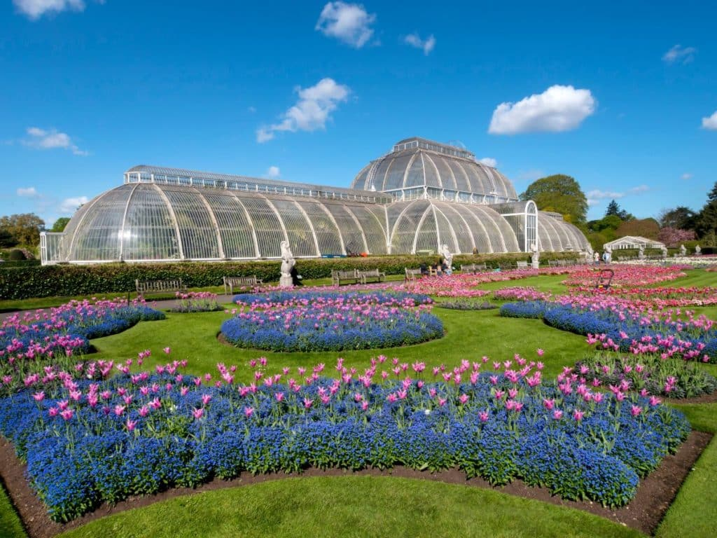

Biology in London Program — Summer 2026
BSC4933 Investigating Questions in Animal Behavior
Have you ever watched your pet, observed squirrels in the park, or visited a zoo and wondered why animals behave the way they do? This course invites students to explore the fascinating world of animal behavior through a scientific lens, using Tinbergen’s Four Levels of Analysis as a framework.
Darwin’s House
Kew Botanical Gardens
Natural History Museum
Grant Museum
London Zoo
Linnean Society
SEA LIFE London Aquarium
People and Nature Lab
Notes:
Private tour of the collections, Natural History Museum

Slide 18
Biology in London Program — Summer 2026
Program Dates and Info
No prerequisites required beyond BIO 2010/L, BIO 2011/L; CHM 1045/L and CHM 1046/L.
Program Application Open Date: Wednesday, October 8th, 2025
IP Scholarship Application Date: Friday, January 2nd, 2026
Commitment Fee Date: January 14th, 2026 $1500
Final Payment Date: February 11th, 2026 ($13,995 total)
London! June 5 – August 2, 2026
*Early application is advisable as program enrollment is limited and acceptances are offered on a rolling basis.

Slide 19
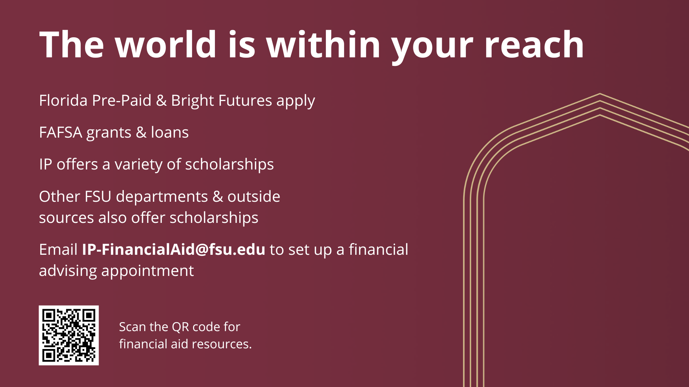

Slide 20
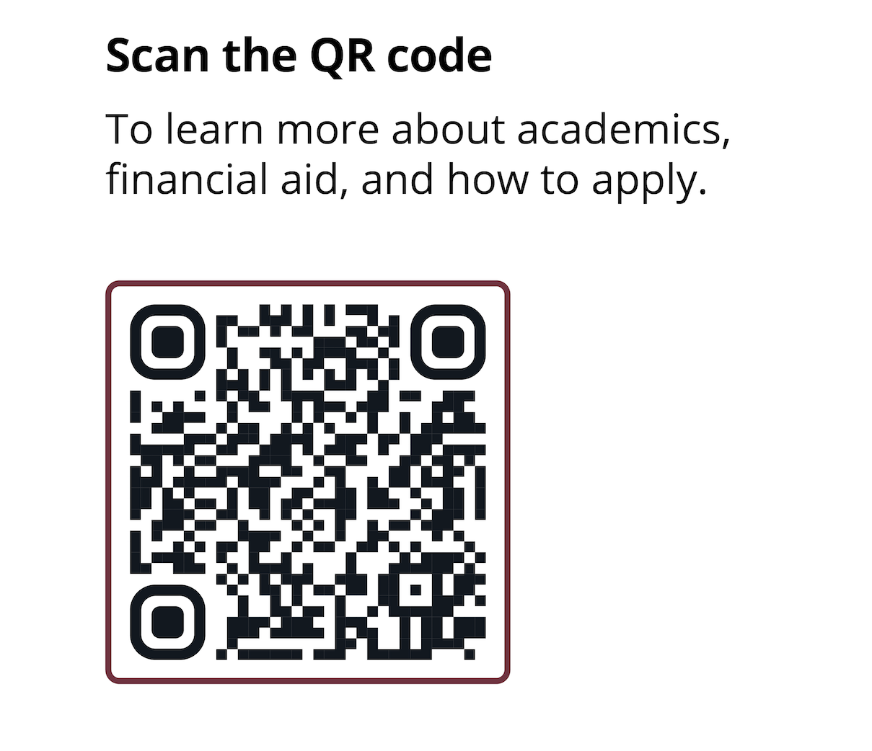
Biology in London Program Summer 2026
For more information:
Dr. Scott Steppan, Bio in London Coordinator (steppan@bio.fsu.edu)
Instructor: Dr. Scott Stagg (sstagg@fsu.edu)
Instructor: Dr. Brittany Kraft (beh10d@fsu.edu)
Biology Dept. Advising office (advisor@bio.fsu.edu)
International Programs (international.fsu.edu) Nadya Rosario (Program Coordinator, ngrosario@fsu.edu) Megan Glogowski (Program Coordinator, mglogowski@fsu.edu) International Programs Advising (IP-AcademicAdvising@fsu.edu) International Programs Financial Aid (IP-FinancialAid@fsu.edu)
https://international.fsu.edu/

Slide 21
For more information:
Scott Steppan, Bio in London Coordinator (steppan@bio.fsu.edu)
Marie Charrel-Dennis (mcharreldennis@fsu.edu)
Dept. Advising office (advisor@bio.fsu.edu)
International Programs Advising (IP-AcademicAdvising@fsu.edu)
International Programs Financial Aid (IP-FinancialAid@fsu.edu)
International Programs (international.fsu.edu)
Nadya Rosario (Program Coordinator, ngrosario@fsu.edu)
Megan Glogowski (Program Coordinator, mglogowski@fsu.edu)

Slide 22
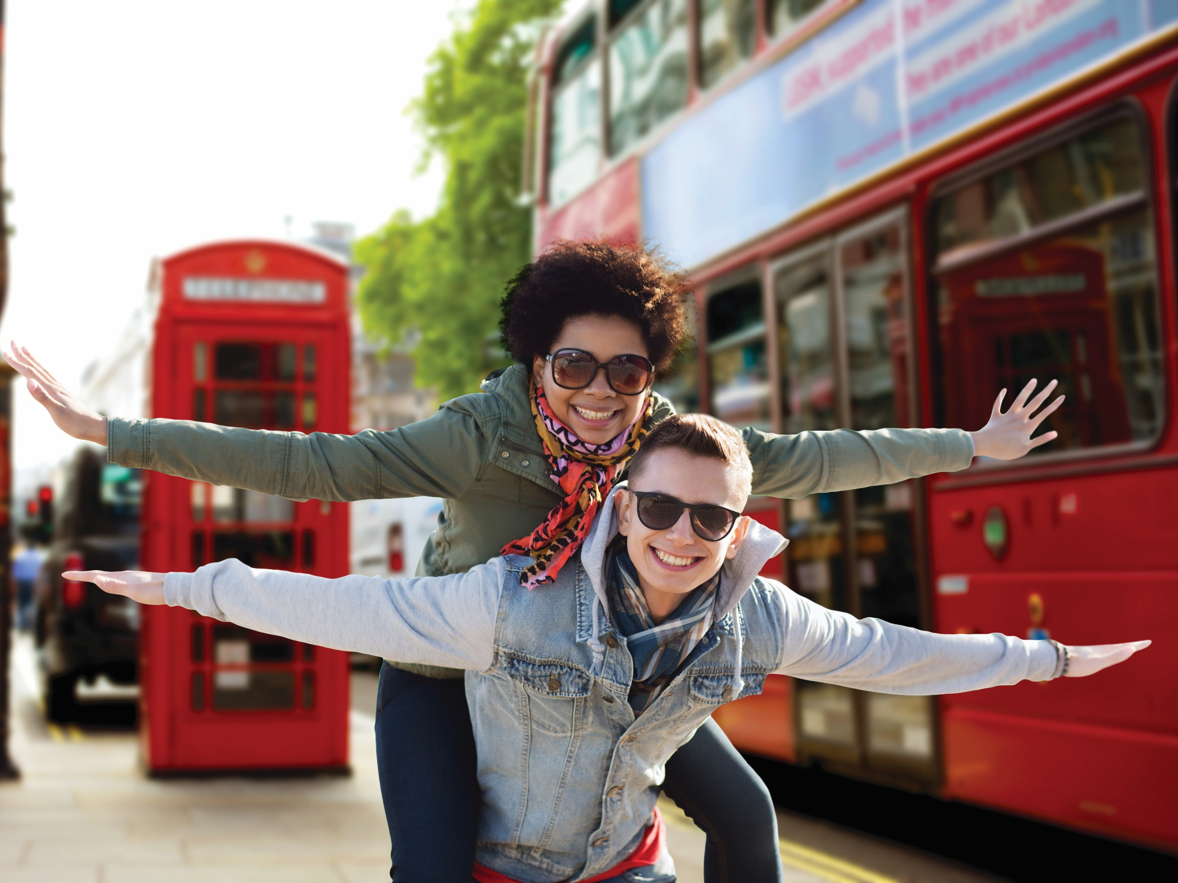

Biology in
London
Notes:
Introductions

